Slide 1
BeSS(Best Subset Selection) method
Best Subset Selection is based on the generalized model and Cox proportional hazard model and implemented by the primal dual active set algorithm.
It can be easily implemented by BeSS library in Rstudio

Slide 2
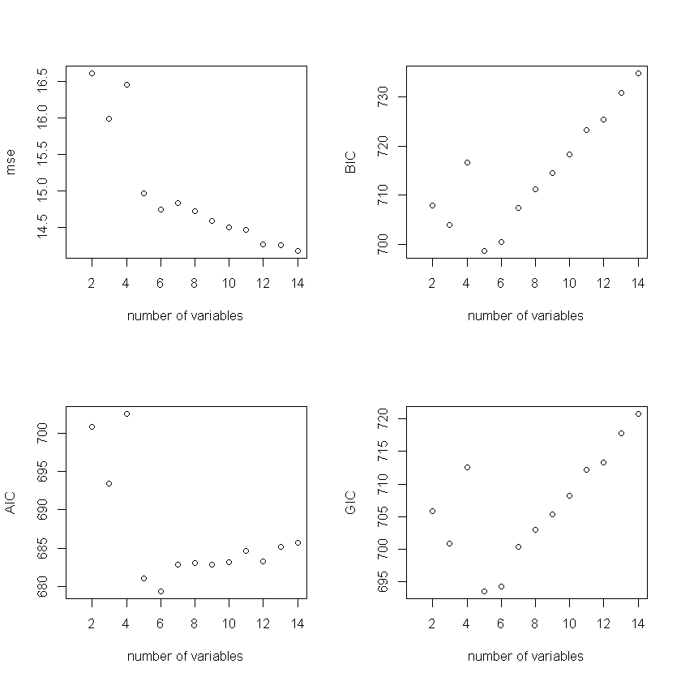
BeSS(Best Subset Selection) method
Calculating the AIC, BIC, GIC and mse using BeSS method, we can compare with different number of variables, the performance of fitted model.
Best variable choices
Mse: 4
AIC: 6
BIC: 5
GIC: 5

Slide 3
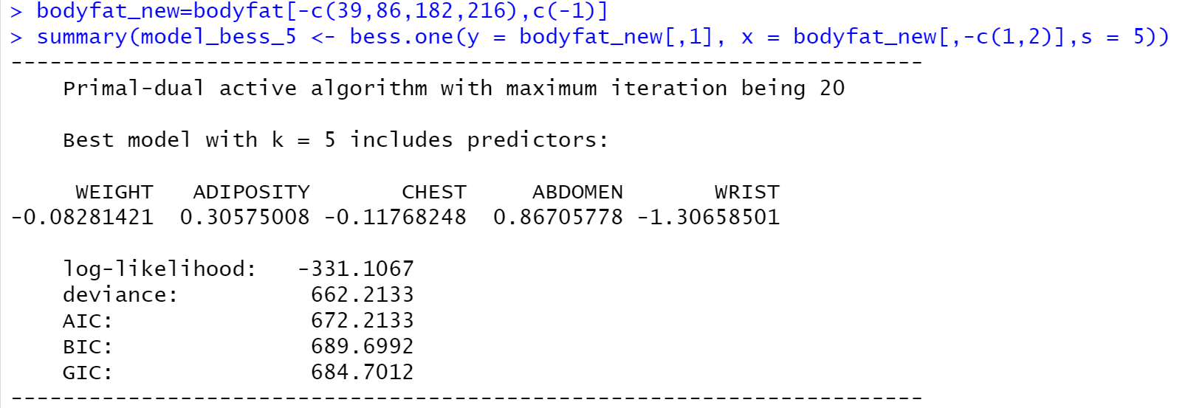
BeSS(Best Subset Selection) method
From the BIC criterion, the best choice is use five variables to fit the model.
Bodyfat ~ WEIGHT + ADIPOSITY + CHEST + ABDOMEN + WRIST

Slide 4
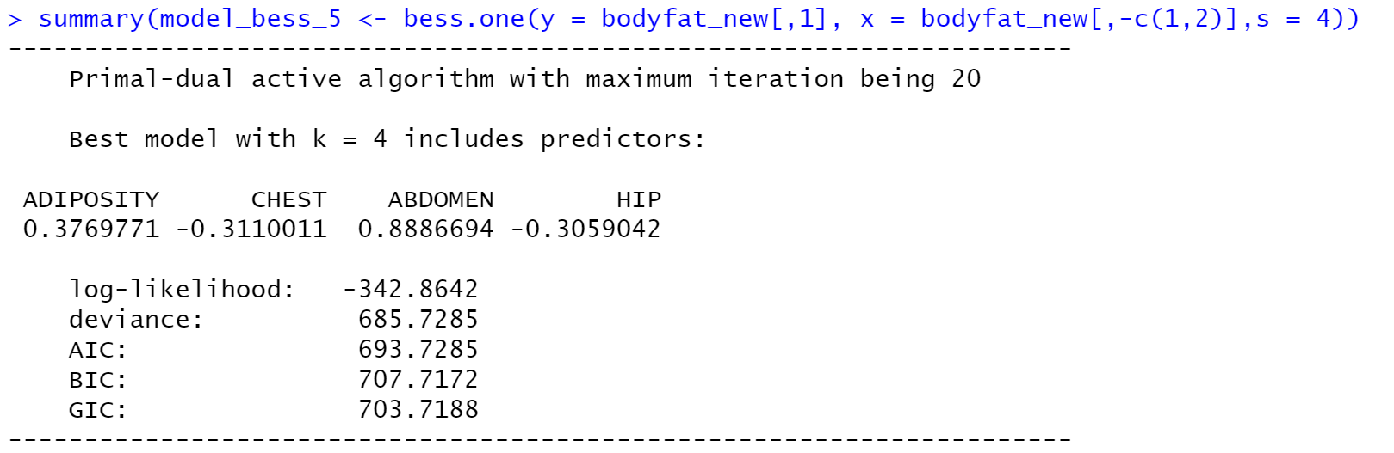
BeSS(Best Subset Selection) method
The optimal choice is five variables, but it is too complicated.
Leave WRIST out

Slide 5
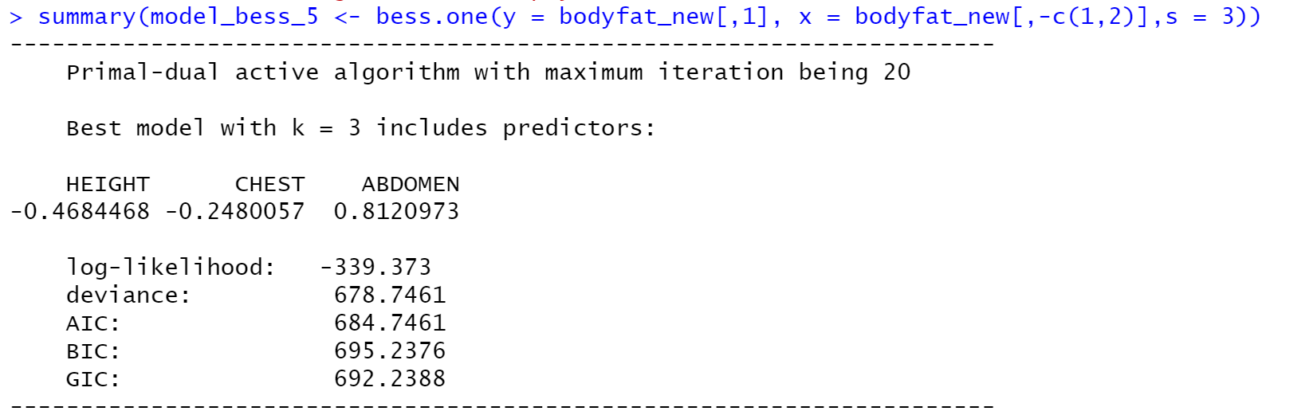
BeSS(Best Subset Selection) method
Try three variables

Slide 6
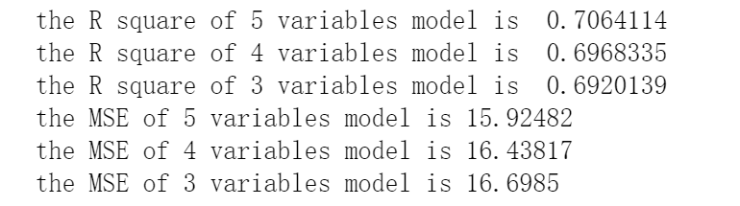
BeSS(Best Subset Selection) method
Considering the Rule of Thumb
Accept three variables model as the optimal choice.

Slide 7
CONTENT:
Dateset Display
Data Cleaning
Multicollinearity Check
Varable Selection
Model Building
Model Interpretation
Model Summary
Model Diagnostic
Discussion

